Slide 1
Travel & Expense Management Solution Built for SAP SuccessFactors

Slide 2
Reimburse Is For All
THE DEFINITION
Reimburse is an AI-enabled & SAP Certified one-stop solution for expense, travel, and benefits management.
Finance Teams
Employees
Managers
THE ACTION
Auto approvals and OCR-based expenditure data input and generation.
AI-based expense approval with detection and flagging of fraud and unexpected expenses.
Streamline the processing of authorized costs and the generation of payment files for payroll systems.
Simplifies the increasingly complex system of managing Employee’s Real-time & Travel Expenses and Benefits they enjoy.
Product By Rolling Arrays
2

Slide 3
THE ALL-IN-ONE ANSWER
Catering to multiple aspects of Corporate Expenses
Expense
Management
Travel Management
Benefits Management
Receipts Management
• Employees log in real-time
expenses
• Managers review expense
requests and accept/reject
• Finance teams can track
expenses & overheads,
generate reports, expedite
approvals, etc.
• End to end handling of all
corporate travel
management
• Encompasses - travel
requests/approvals, cash
advances, travel agents
assignment, bookings,
expense claims,
settlements, and insights
through reports
• Seamless managing of
all employee benefits –
from wellness to
company ones
• Configurable workflows,
real-time actions, and
comprehensive reporting
in an integrated solution
module
• OCR technology
automates receipt
capturing and
management within a
central repository
• Further eased with the
mobile application
enabling receipt capture
in real-time and AI-
enabled processing
Product By Rolling Arrays
3

Slide 4
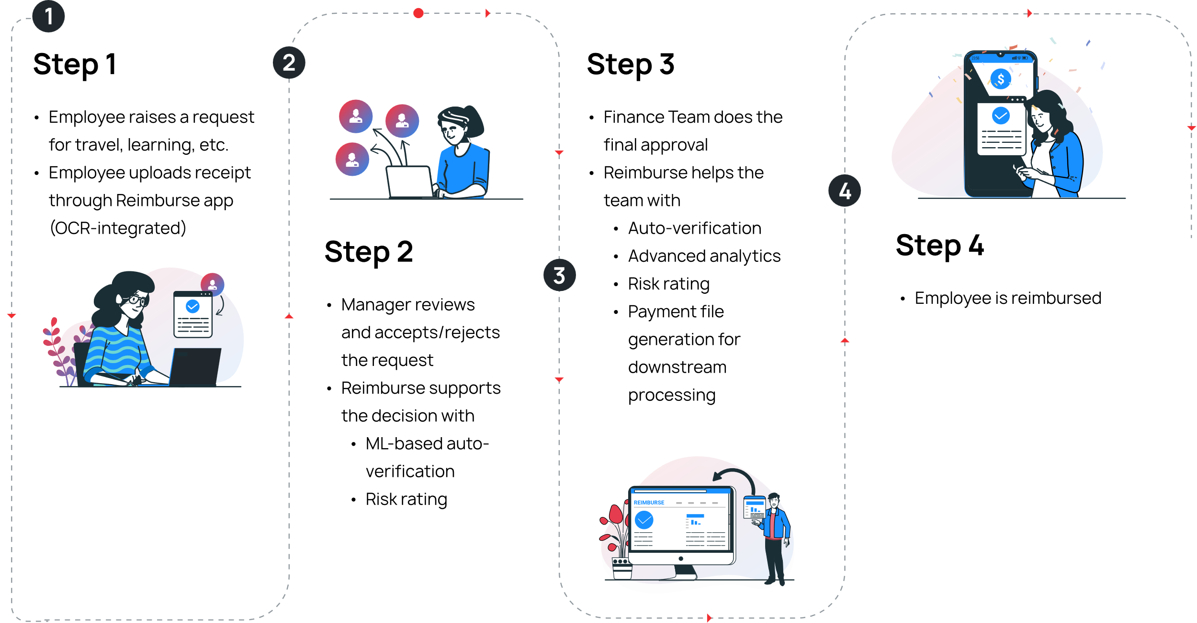
SOLUTIONS AUTOMATED APPROACH
The Journey From Expense To Simplified Expense Management
Product By Rolling Arrays
4

Slide 5
FEATURES
Build for SAP SuccessFactors
Expense Management
Travel Management
Pre-integrated with SAP SuccessFactors. A cloud-based solution deployed on the SAP Cloud Platform and supports single sign-on (SSO) with SAP SuccessFactors​.
Manage expense-specific categories like general, mileage, entertainment, per diem, petty cash, company policies, rules, workflows, and reports.
For enterprises, business travel is crucial to expanding operations. Travel managers can use Reimburse to streamline travel booking requests. Keep track of incoming or approved requests in one place.
Benefits Management
Receipts Management
Be it wellness benefits or gift cards, or giving credits as freebies – ease the arrangement, decision, and management of giveaways and similar employee benefits.
With our OCR technology, eliminate the efforts of doing paperwork and automate all the processes of receipt capturing, converging, and management within a central repository and with a few clicks.
Product By Rolling Arrays
5

Slide 6
PLATFORM FEATURES
Enabling Multiple Possibilities In One Single Location
1
2
3
4
5
Receipt capture, receipt scanning (OCR), and duplicate receipt detection
Audit trails and full control on policies, with smart action cards and reports
Entitlement, claims, available balance details, and T&C in an intuitive interface
Dedicated approval inbox and one-click email approvals & bulk approvals
Multi-country & organizational structure setup with local language and currency ops
6
7
8
9
10
Dynamic rule engine with delegation ability to assign roles and permissions
Dedicated implementation and support team
Automatic request settlement with centralized and automated finance settlements
Dedicated reporting with custom/standard report templates with advanced filters
Integration suite for HR and finance/accounting software’s
Product By Rolling Arrays
6

Slide 7
THE BENEFITS EXPERIENCED
Into A World Of Simplified Expense Management
Travel
Managers
Finance
Teams
Employees
Admin
l On-spot adding/scanning of expenses
l Reduced last-minute billing & manual receipts hassles
l Diverse features access - Custom approval workflow, policy inspector, travel authorization, and reports
l Eased handling of employee requests
l Streamlined travel booking requests
l Eased tracking & approval of incoming requests - in one place
l Track ability of employee spending patterns
l Assistance in ensuring compliance with audit trails
Product By Rolling Arrays
7

Slide 8
PROVEN PLATFORM POINTERS
PARTNER CERTIFICATION
PROVEN RATINGS
AND A STRONG LIST OF CLIENTELE
Product By Rolling Arrays
8

Slide 9
EXPLORE REIMBURSE
Experience A Simplicity In Expense Management Tomorrow
reimburse@rollingarrays.com

