Slide 1
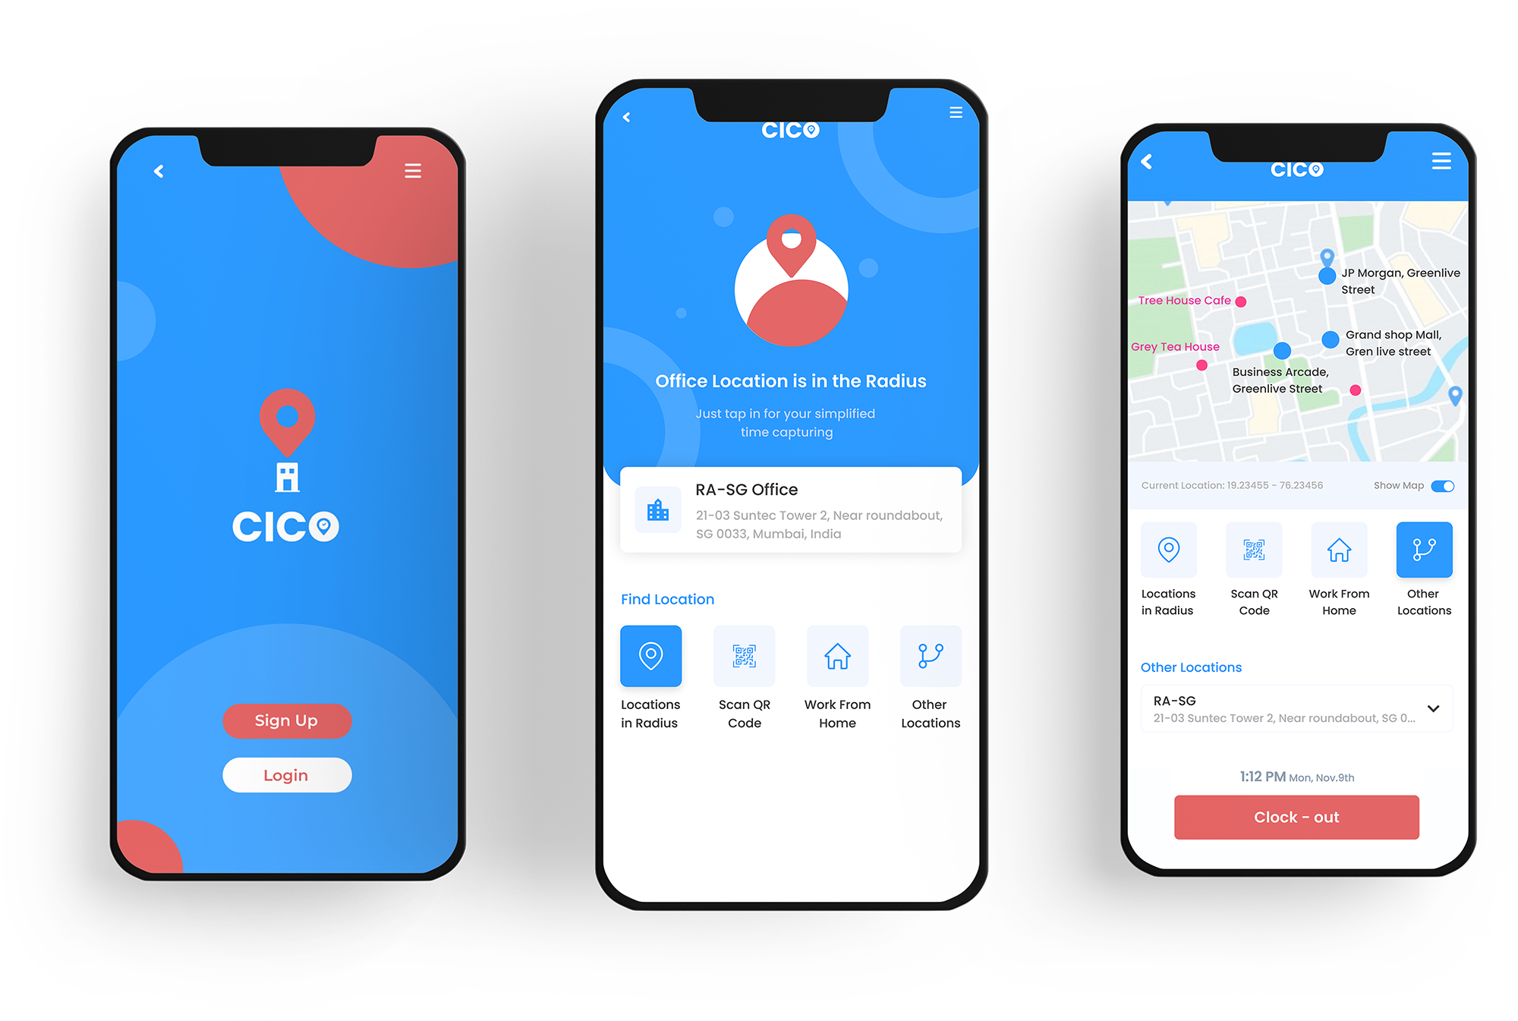
The New-Normal Of Intelligent Time Capturing
Clock In & Clock Out (CICO) Contact Free & Captured Real-time

Slide 2
Why Time Capturing Needs Revision?
Reasons To Reshape Biometric Based Clock Ins/Outs
To Maintain ‘No Contact’ Yet Capture Time
To Go Maintenance-Free & Keep Up With Tech
Due to Covid19 biometric touch identification can be a major infection source. CICO is contactless, internet-less & queue-less.
As CICO uses users' mobile for clock-in & clock-out, it doesn't require regular maintenance & can be scalable to keep up with technology.
To Bring Efficiency And Optimize Productivity
The lag between physical biometric & downstream scheduling systems can result in losing precious work hours & delayed operational decisions.
2

Slide 3
CICO In A Nutshell
Embrace The New Normal Of Intelligent Time Capturing
A new-age mobile app to phase out biometric time capturing devices for contactless CIs and COs and enable operational decision-making with real-time data and intelligent alerts.
The app leverages the pre-built identification systems in a phone to authenticate someone’s presence and availability.
3

Slide 4
Features Factored In
Key Features At Its Core
Time Capturing
Geofencing
Face / Finger Recognition
QR Code
4

Slide 5
Features Factored In
Key Features At Its Core
Offline Mode
No Internet, No Problem!
Warehouses, Basements, Remote places, High-Security places - CICO supports even the areas with no internet connections
5

Slide 6
Features Factored In
Key Features At Its Core
Intelligent Alerts & Real Time Insights
Intelligent – with intelligent & realtime alerts, CICO empowers supervisors with real-time insights on employee clock in or clock out and frauds prevention features.
6

Slide 7
Features Factored In
Key Features At Its Core
Other Features
Dynamic Rule Engine
Pre-Integrated with SAP
Available on both iOS & Android
Dedicated Support
7

Slide 8
CICO Makes Things Simple For All
Be It Employees. Be It The Enterprise.
Employee
Administrator
Enterprise
Employees stay safe and avoid queues – every day.
Complete and instant visibility on movement, time utilization, and detailed reports benefit administrators..
Improved employee productivity
and informed decisions by their supervisors benefit business processes..
8

Slide 9
Why Consider CICO?
Internet-less
Contactless
Queue-less
Works online and offline, so clock in and clock out and their tracking doesn't get hampered.
Facial or finger recognition on smartphones to allow clock in or clock out on the go.
QR code scanning inside the premises also enables to avoid standing in a long queue.
Seamless
Lagless
Maintenance-less
Gets easily integrated with HRIS software to provide seamless reports.
Instant CI/CO alerts and geofencing notifications save the time of supervisors.
CICO doesn’t require regular maintenance and can be scalable to keep up with technology.
9
9
9
9

Slide 10
Embrace The New Normal With CICO
cico@rollingarrays.com
10

